Slide 1
VEGETABLE RECOGNITION AND PRICE VIEWER SYSTEM
Project supervisor
Er. Sudarshan subedi
RABIN GHIMIRE (073/BCT/28)
ANIL SHRESTHA (073/BCT/50)
AJIT DHAMI (073/BCT/51)
March, 2020

Slide 2
Introduction
Recognizing different kinds of vegetables is perhaps the most difficult task in supermarkets and fruit shops and people also need to ask the price of every vegetable price to shopkeeper.
This projects aims to solve this problem by recognizing the vegetable and view its currenty market price of the vegetable. Also prevents consumer from being paid overpriced.

Slide 3
Objective and Scope
To develop the system that recognize vegetable from the real time live camera using CNN.
To get the current market price of the recognized vegetable.

Slide 4
Application and Scope
Consumers can use this system to recognize vegetable and get its price that prevents them from paid overpriced.
Supermarket and vegatable storages can use this system to distinguish vegatable using machines and prevent the vegetable to be mixed up

Slide 5
Requirement Analysis
Feasibility Analysis
Economic Feasibility
Technical Feasibility
Operational Feasibility
Requirement Analysis
Functional Requirements
Non-Functional Requirements

Slide 6
Tools and Techniques
Python
Tensorflow
OpenCV
Pandas
Keras
Matplotlib
NumPy
Anaconda
PyCharm
BeautifulSoup
PyQt5

Slide 7
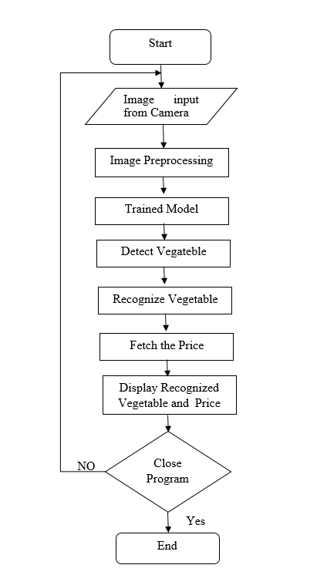
System Design
Flowchart Diagram

Slide 8
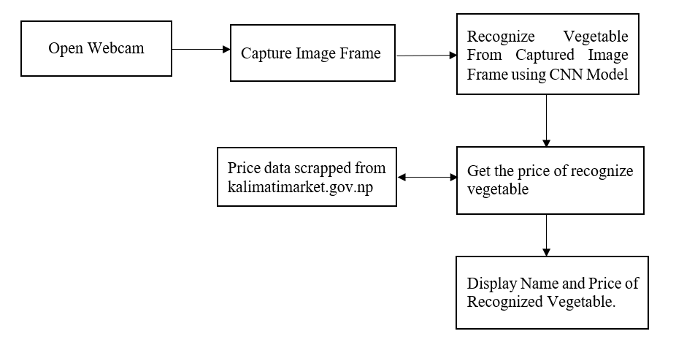
Block Diagram

Slide 9
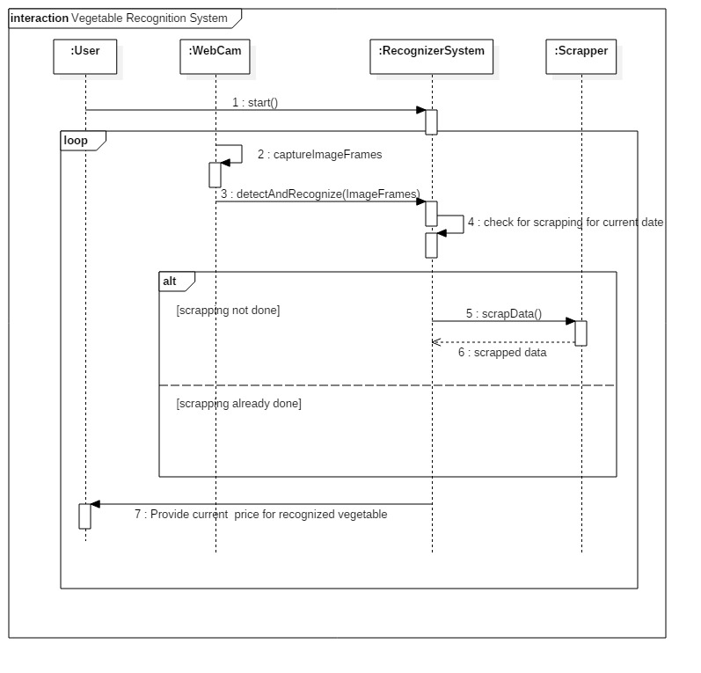
Sequence Diagram

Slide 10
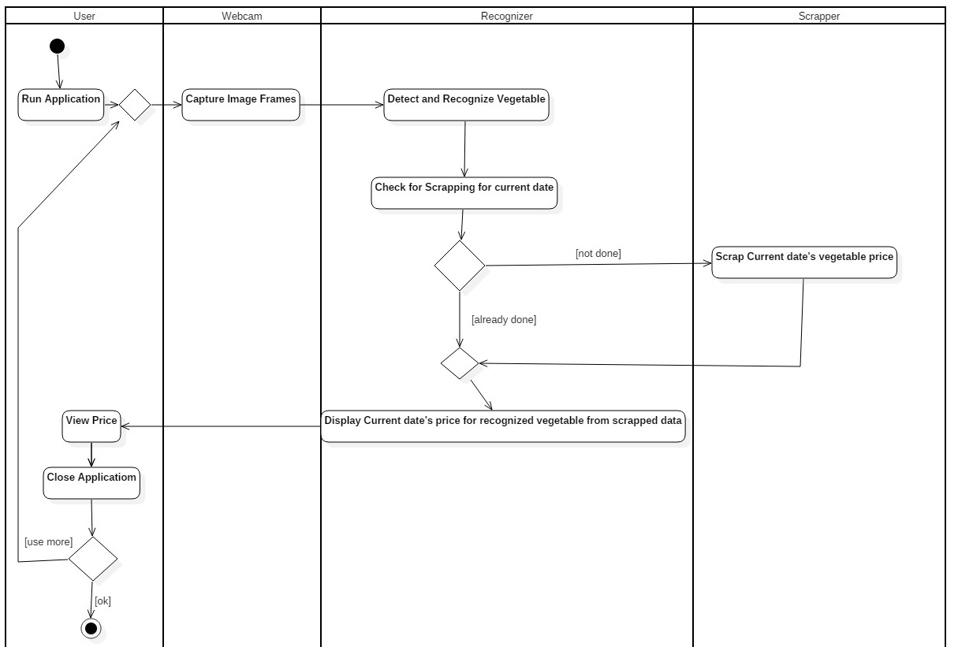
Activity Diagram

Slide 11
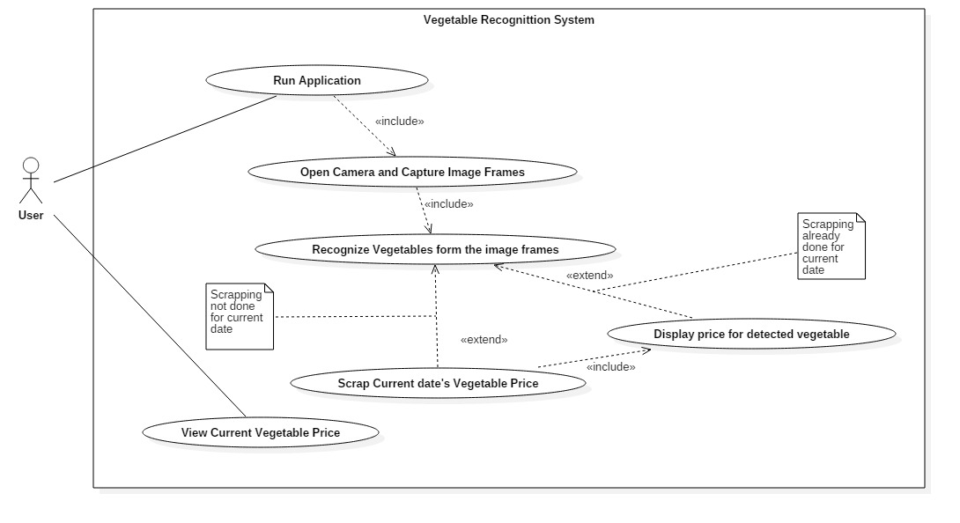
Use Case Diagram

Slide 12
Methodology
Collection of Vegetable images
Fruits360 dataset from kaggle is used for dataset.
More than 1300 images for each class.
Preparing the Images to Train:
Three different vegatables; Onion, Tomato and Potato
Image size used is 50*50.
These images are kept into different paths/directory and are labeled.

Slide 13
Model Creation and Training
Convolutional Neural Netwok is used to train the images.
The detail on the architecture of CNN used in this project is explained in next slide.
Set up for the live images from camera module
OpenCV is used for the live video capturing from the camera.
The vegetables is detected as soon as the system detects any images of vegetables in the live video.
. The frame of the video is taken and the frame is used to predict the vegetable that is shown in the camera.

Slide 14
Web Scrapping
The price of vegetable is scrapped from the website: kalimatimarket.gov.np. Using BeautifulSoup Library.
As soon as the system detects the vegetable, the price of the recognized vegetable is displayed along with its Name.
GUI
PyQt5 is used for making simple GUI to make the system easy to use.
A window is displayed that has a simple UI, consist of Button labeled “Open camera”. It opens the camera and starts to capture video.

Slide 15
Algorithm
CNN Algorithm
A Convolutional Neural Network (ConvNet/CNN) is a Deep Learning algorithm which can take in an input image, assign importance (learnable weights and biases) to various aspects/objects in the image and be able to differentiate one from the other
A CNN has
Convolutional layers
Pooling layers
ReLU activation function
a Fully connected layer

Slide 16
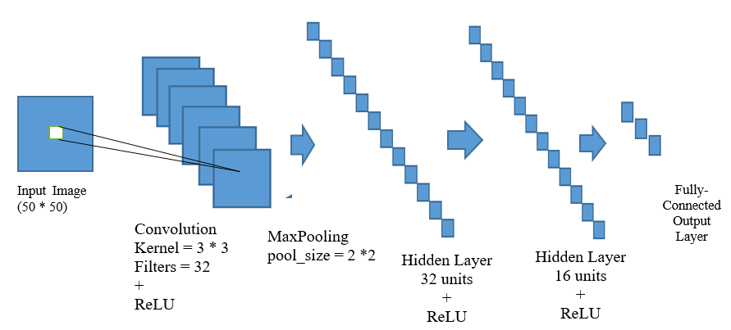
CNN Architecture of our Project:

Slide 17
Result and Analysis
The UI of the system is simple and user friendly.The CNN has been tuned to get the better accuracy in recognition
The training accuracy is 98.55% and training loss is 4.90% and the validation accuracy is 99.76% and validation loss is 2.22%.

Slide 18
THANK YOU

